Slide 1
Integration mRUBiS with external Controller
Slides based on
Paul Wullenweber
Kim-Pascal Borchart
August 3rd, 2021
Machine Learning-based Control of Dynamical Systems

Slide 2
Requirements
Launch mRUBiS
Communicate from external process
Observe mRubis states
Assign the order of fix execution

Slide 3
Communication – observing states
mRUBiS
Issues handled individually
Encapsulation
Complex Architecture
quick solutions:
persist required data to disk (json)
copy individual issue flow

Slide 4
Communication – initial connection
Controller
mRUBiS
launch (subprocess) | optional
open socket
connect to socket

Slide 5
Communication – initial states
Controller
mRUBiS
QUERY(total # of shops)
RESPONSE(total # of shops)
QUERY(initial state per shop)
RESPONSE(initial state per shop)

Slide 6
Communication – within run
Controller
mRUBiS
# of issues in current run
current issue, available actions
pick action for issue (lowest cost)
specify order of execution (utility)
update fixed components

Slide 7
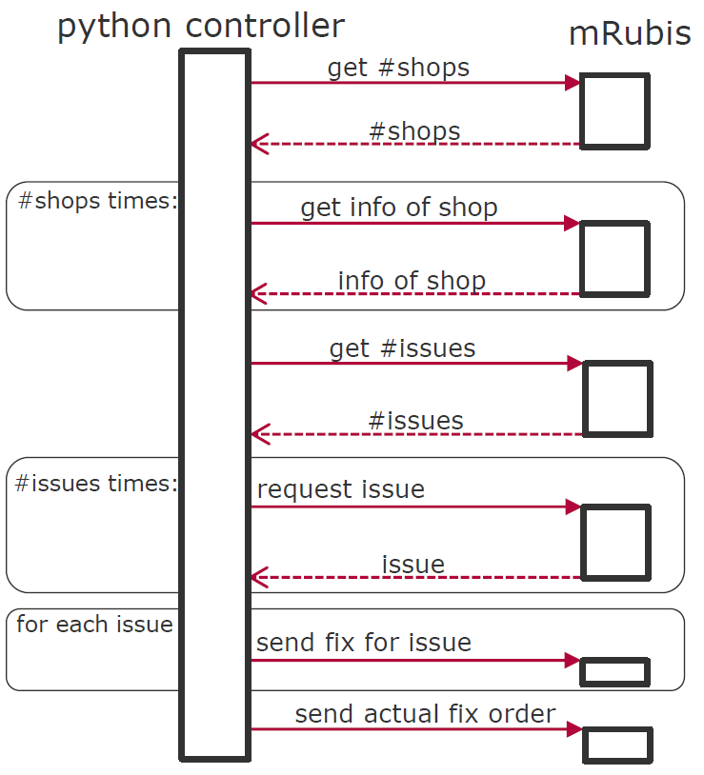
Sequence Diagram
GitHub Repo:
https://github.com/hpi-sam/MachineLearningControl

Slide 8
Executing Control Strategies
Which action to take?
Compare available actions per issue
Which issue to address first?
Compare components within and between shops

Slide 9
Three Control Strategies
Random issue ordering
Cost-based issue ordering
Predicted-utility-based issue ordering

Slide 10
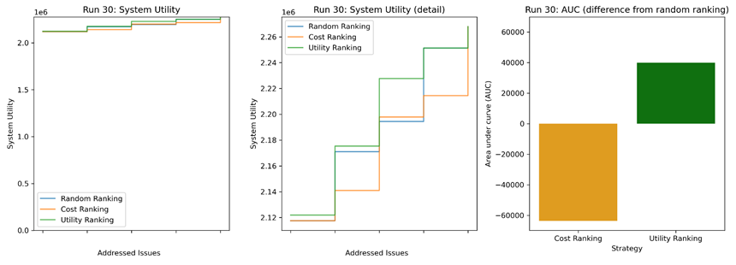
Issue ranking – example run
1
2
3
4
5
1
2
3
4
5

Slide 11
End

